Slide 1
PCW LESSON PLAN!!!
11/1/13
HAPPY DAY OF THE DEAD!!!

Slide 2
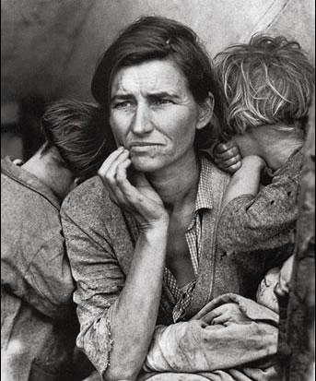
“MIGRANT MOTHER”
REVISITED

Slide 3
SPOILER ALERT: THIS PHOTO WAS STAGED
What aspects of this photo do you think might have been staged?
What might the photographer, Dorothea Lange, have manipulated in this photo?
What kind of message did she hope to convey, and how might staging and/or altering certain parts of the image have accomplished that?

Slide 4
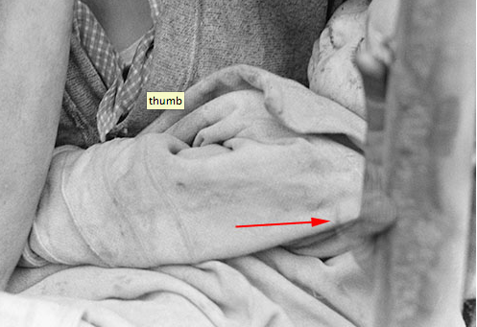
STAGED ASPECTS OF THE PHOTO
PHOTOSHOPPED THUMB!

Slide 5
STAGED ASPECTS OF THE PHOTO
THE TWO BOYS IN THE PHOTO = POSED
ORIGINAL SUB-HEADING: “Destitute pea pickers in California. Mother of seven children. Age thirty-two. Nipomo, California.”
BUT FLORENCE OWENS THOMPSON WAS NOT A PEA-PICKER AT ALL!!!

Slide 6
THE REALITY...
Florence Owens Thompson, the woman in the photo, did not actually live on the pea-picking farm at all.
She was simply waiting for her husband, who had gone into town in order to fix his car (more specifically, his car timing chain) (Schoettler 1).
She was also a Cherokee Indian, rather than a Euro-American “migrant mother” that she was perpetuated to be.
“‘'I wish she [Lange] hadn't taken my picture. I can't get a penny out of it. She didn't ask my name. She said she wouldn't sell the pictures. She said she'd send me a copy. She never did’” (McCormack 1).
“‘There was no food,’ she says. ‘We were ashamed of it. We didn't want no one to know who we were’” (Gutierrez& Drash 1).

Slide 7
SO...WHY “STAGE” IT?
FOR POLITICAL REASONS…
“Within days, the federal government shipped 20,000 pounds of food to the pea-picker camp. But by the time the food arrived Thompson and her family had moved on” (Schoettler 2, emphasis added).

Slide 8
ANALYZING MASS MEDIA TODAY…

Slide 9
CRITICALLY THINKING ABOUT DOVE’S ADVERTISEMENT...
Who is producing this commercial? Are they a reliable, “objective” source?
What preconceived notions/ideas might we have about Dove and their “Real Beauty” Campaign?
What messages are being sent through this video?
Who is their intended audience?
What emotions are they trying to provoke?
What products AS WELL AS ideas are they trying to “sell?”

Slide 10
INTRO TO REMIX PROJECT!!
You will have the chance to “remix” one of your previous assignments!!!
THINK CREATIVELY!!!

Slide 11
INTRO TO REMIX PROJECT!!!
IN ORDER TO BEGIN EXPLORING AND THINKING ABOUT THIS REMIX PROJECT:
USE EITHER storyboardthat.com or photopeach.com
Illustrate your culture shock experience through storyboarding, or illustrate it through PhotoPeach.
-OR- illustrate your argument from assignment #3 through storyboarding, or illustrate it through photos using PhotoPeach.

Slide 12
IF YOU’D LIKE TO CONTACT MS. KADRI
MY EMAIL IS: kadrira1@msu.edu
Feel free to contact me with ANY questions!!
Please put either PCW or WRA in the subject title of your email so that I know to look at it!

Slide 13
Works Cited
Colberg, Jörg M. "Looking at Dorothea Lange’s Migrant Mother." CPHMANG. CPHMANG, 2013. Web. 31 Oct. 2013.
"Dove Real Beauty Sketches." YouTube. YouTube, 14 Apr. 2013. Web. 31 Oct. 2013.
"Florence Owens Thompson." Wikipedia. Wikimedia Foundation, 10 Nov. 2013. Web. 31 Oct. 2013.
Guiterrez, Thelma, and Wayne Drash. "Girl from Iconic Great Depression Photo: 'We Were Ashamed'" CNN. Cable News Network, 3 Dec. 2008. Web. 31 Oct. 2013.
Hariman, Robert, and John Louis Lucaites. "No Caption Needed." Migrant Mother. University of Chicago Press, 2007. Web. 31 Oct. 2013.
McCormack, David. "'I Never Lost Hope': Startling Interview Unearthed with Woman behind Iconic Great Depression Image Talking Just Five Years before Her Death in 1983." Mail Online. Associated Newspaper Ltd., 9 Mar. 2013. Web. 31 Oct. 2013.
Nash, Meredith. "A Brand for Social Change? The Myth of Dove’s ‘real Beauty’." The Conversation. The Conversation Trust, 9 July 2013. Web. 31 Oct. 2013.
Schoettler, Carl. "A True Picture Of Hard Times." Daily Press. The Daily Press, 12 Nov. 2002. Web. 31 Oct. 2013.
Sehiralti, Zeynep. "The Real Migrant Mother: The Alteration of Reality in the Photographs of Dorothea Lange." Yahoo Contributor Network. N.p., 28 Nov. 2008. Web. 31 Oct. 2013.

