Slide 1
PCW LESSON PLAN!!!
10/25/13

Slide 2
ACTIVITY #1: STUDYING DIFFERENCES IN WRITING ACROSS VARIOUS CULTURES
How is the writing that you have been doing in this class different from the writing that you did in high school, whether you lived inside or outside the United States?
How might we be asking you to present ideas or use evidence differently in your writing in comparison to your home country/town?
Please provide as many details and examples as you can :)

Slide 3
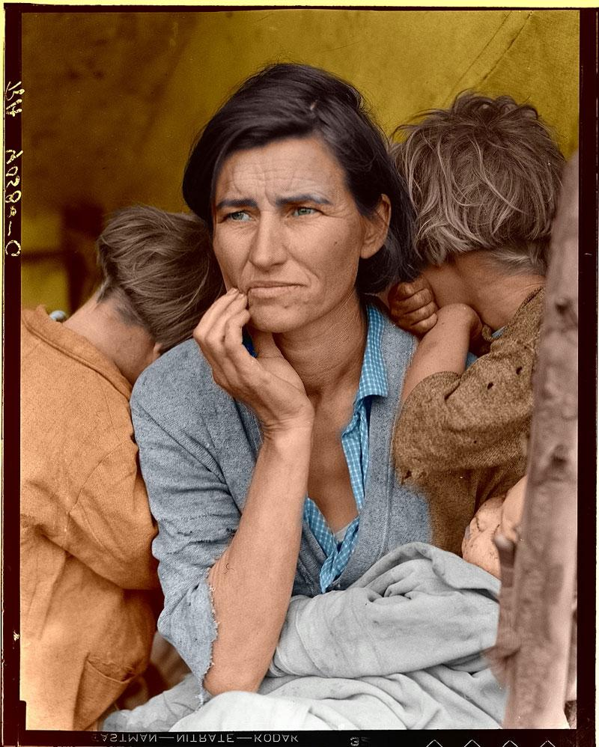
ACTIVITY #2: “A PICTURE IS WORTH A THOUSAND WORDS”:THE POWER OF IMAGES
Notes:
Make sure to ask: What kinds of questions do you immediately begin to ask yourself when looking at this picture? No responses, please, just questions :).

Slide 4
ACTIVITY #2: SUGGESTED LEADING QUESTIONS TO CONSIDER:
How is the woman in this photo feeling, and what emotions are being depicted in this image?
Where is this woman?
Who are the children around her?
How old is this woman?
What is her life like?
Where does she live, and who might she live with?
What was this individual’s day, or even week like before this picture was captured on film?
What is this woman experiencing right now?
What does this woman’s future look like?

Slide 5
LARGE GROUP DISCUSSION:
Did you find it easy or difficult to imagine and create a story about this woman and her life?
What kinds of emotions did you feel she was experiencing, and what made you feel that way?
What aspects of the photo inspired the story you created?

Slide 6
“MIGRANT MOTHER”
The woman in the photo is named Florence Owens Thompson, and who, as the title of the photograph suggests, was a migrant mother.
This photo was taken in Nipomo, CA, in 1936 in the midst of the Great Depression by a photographer by the name of Dorothea Lange.
http://www.ganzelgroup.com/movies/thompson.html#

Slide 7
“MIGRANT MOTHER”
“I saw and approached the hungry and desperate mother, as if drawn by a magnet. I do not remember how I explained my presence or my camera to her, but I do remember she asked me no questions. I made five exposures, working closer and closer from the same direction. I did not ask her name or her history. She told me her age, that she was thirty-two. She said that they had been living on frozen vegetables from the surrounding fields, and birds that the children killed. She had just sold the tires from her car to buy food. There she sat in that lean- to tent with her children huddled around her, and seemed to know that my pictures might help her, and so she helped me. There was a sort of equality about it” -Dorothea Lange
(From: Popular Photography, Feb. 1960).

Slide 8
GOOD WEBSITE FOR THOSE WHO WOULD LIKE TO CREATE A GRAPH/PIE CHART:
http://nces.ed.gov/nceskids/createagraph/default.aspx?ID=9f10b75613d146538cc71840c3b6f532

Slide 9
Works Cited
Lange, Dorothea. Migrant Mother. 1936. Photograph. Nipomo, California. The Guardian. The Guardian. Web. 23 Oct. 2013.
"Dorothea Lange's "Migrant Mother" Photographs in the Farm Security Administration Collection: An Overview." Prints & Photographs Reading Room. The Library of Congress, 24 Jan. 2013. Web. 23 Oct. 2013.
"Migrant Mother, Florence Thompson." Ganzel Group. Ganzel Group, n.d. Web. 23 Oct. 2013.

